Slide 1


User experience quality improvement
Name :
Saleh Ahmad Alheeh
Student ID :
201614721
Subject:
SWE312 User-Interface Design

Slide 2
Outline
Introduction
The main factor is the success of popular applications
comparison between two applications in terms of user experience
User experience quality improvement

Slide 3
Introduction
User experience (UX) is a person's emotions and attitudes about using a particular product, system or service.
The user experience may be good or it may be bad, accordingly, competition is being provided for who provides his services in the best way for the user to win his satisfaction and outperform other competitors as he achieves success for his customers and businesses, and those who suffer from providing a good use experience for not understanding the nature of the user or customer, which makes it in The end to their failure to achieve their goals.

Slide 4



Introduction
The ISO 9241-210 system defines the user experience as a person's perceptions and response resulting from the expected use or use of a product, system, or service. According to the ISO definition, the user experience includes all the user’s emotions, beliefs, preferences, perceptions, physical and psychological reactions, behavior, and accomplishments that occurred before, during, or after use. The definition also includes three factors that are far apart on the user experience:
the system
the user
Use environment.

Slide 5

The main factor is the success of popular applications
The main factor in the success of these applications is the good user experience, as it is the cut-off that determines whether the application will have the user’s satisfaction, neglect or even indignation, there are many chat programs that mimic WhatsApp as a social communication tool, but the reason why WhatsApp remains at the forefront Due to his interest in making the experience superior and satisfactory to the maximum extent, the only solution to take off WhatsApp from the seat of the user’s experience in chat programs is for another program to outperform him in a better use experience. The satisfaction of people (or the user in this context) is an unrecognizable goal, and the user is in constant aspiration for a better experience.

Slide 6




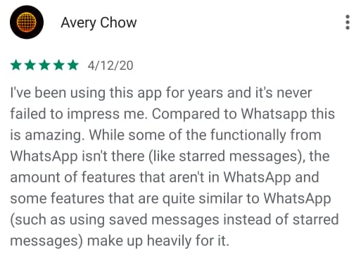
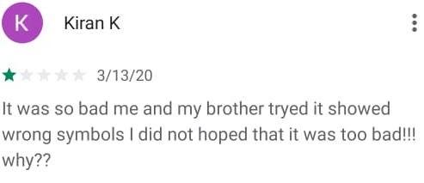
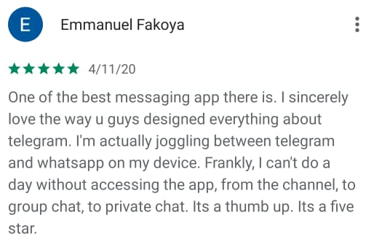
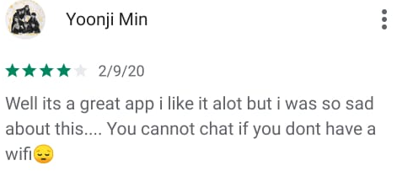
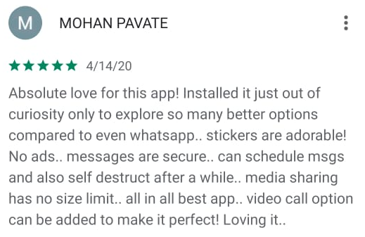
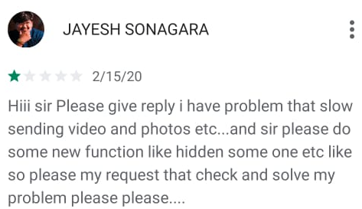
comparison between two applications in terms of user experience
VS
Telegram
Typi Messenger
We now notice the difference of user opinion according to the user experience
Typi Application that got a bad user experience, which led to low rating and fewer downloads compared to the Telegram application.
Telegram application that got a Good user experience. Which leads to a rise in the acceptability of users to it and increases its downloads and rating.

Slide 7
User experience quality improvement
Useful.
Usable.
Desirable.
Findable.
Credible.

Slide 8
User experience quality improvement Useful, Usable, Desirable.
Useful.
ask whether our products and systems are useful, and to apply knowledge of craft ,and define innovative solutions that are more useful.
Usable.
Ease of use remains vital, and yet the interface-centered methods and perspectives of human-computer interaction do not address all dimensions of web design. In short, usability is necessary but not sufficient.
Desirable.
Our quest for efficiency must be tempered by an appreciation for the power and value of image, identity, brand, and other elements of emotional design.

Slide 9
User experience quality improvement Findable, Credible.
Findable.
must strive to design navigable web sites and locatable objects, so users can find what they need.
Credible.
the user experience must advance the mission. With for-profits, it must contribute to the bottom line and improve customer satisfaction.

Slide 10
Conclusion
The user experience is very important for the success of applications and websites because it provides a deep understanding of the user.
The presentation mentioned the definition of user experience and three factors that are far
apart on the user experience and the main factor is the success of popular applications, comparison between two applications in terms of user experience and User experience quality improvement
Sources:
https://semanticstudios.com/user_experience_design/
https://en.wikipedia.org/wiki/User_experience

